Slide 1


Raising Funds For Infrastructure
Projects From DFIs
June 2014

Slide 2

Outline
Introduction to The Africa Finance Corporation (AFC)
Advantages & Misconceptions About DFI Financing
Raising Funds From DFIs: Risks, Process
Conclusion

Slide 3

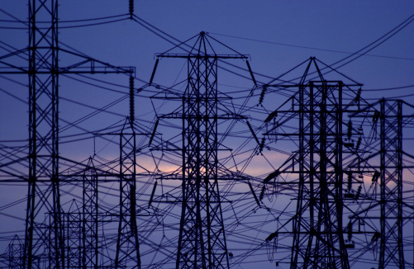
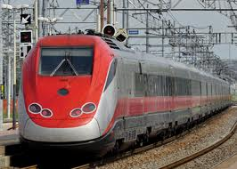
The Africa Finance Corporation
AFC, formed to help fill a void in Africa’s infrastructure
AFC is a private sector led, International finance institution
Established by international agreement in 2007
Formed to help address Africa’s infrastructure needs by providing long term financing solutions
Carefully selected focus sectors that have both a high development impact and strong investment returns
  These include: Natural resources (Oil and gas, mining),power, telecoms, transport and heavy industry
Ability to participate across the capital structure using a number of products: technical & financial advisory, project finance, equity, convertibles, mezzanine, finance and project development
  AFC has US$ 1.9bn in total assets with an active investment portfolio of over US$ 1.3bn
  A3 investment grade international credit rating by Moody’s - Top 4 rated institution in Africa

Slide 4
Membership & Project Spread
AFC’s Membership Status
Investment Footprint
Morocco
Cape
Verde
Mali
Senegal
Niger
Chad
Cape
Verde
Gambia
Senegal
Guinea
Conakry
Guinea
Benin
Gambia
Guinea
Togo
Sierra Leone
CIV
Togo
Nigeria
Sierra Leone
Nigeria
Ethiopia
Somalia
Liberia
Ghana
Ghana
Cameroon
CIV
Cameroon
Uganda
Kenya
E. Guinea
Uganda
Gabon
Kenya
Current Members
Nigeria (Host Country)
Ghana
Guinea Bissau
Sierra Leone
The Gambia
Liberia
Guinea Conakry
Chad
Cape Verde
Tanzania
Tanzania
Zambia
Mozambique
Angola
Zambia
Malawi
Zimbabwe
Mozambique
Botswana
South Africa
Mauritius
Prospective Members
Cameroon
East African Community States
Zambia
Mozambique
BCEAO (Central Bank of West African States)
Mali
Current Members
Investment Footprint
Prospective Members
Projects Reviewed But Not Closed

Slide 5
Building Expertise in High Impact Sectors
AFC has prioritised sectors that have both high profit and development impact potential
Our success over the last few years, has proven that this model is doable and sustainable
Priority 3
Priority 2
Priority 1
Current focus is on originating and executing transactions in the following sectors:
Natural Resources: Oil, Gas and Mining, Near Production and Associated Services
Power: IPPs, Emergency Power, Gas-to-Power, Coal, Renewables, Distribution, Transmission
Transport Infrastructure: Roads, Rail Aviation, Ports, Marine, Logistics
Heavy Industries: Fertilizer, Cement, Refining, Petrochemicals
Telecom: Operators, Infrastructure, Shared Services
Retail
Trade
Social Infrastructure ▪
Financial
Services
    Urban Infrastructure
    Agriculture ▪
Natural Resources
  Telecom
  Transport
  Heavy Industry
    Power
Investment Attractiveness
Developmental Impact
Focusing on these few sectors where AFC can make a significant impact has also allowed us the opportunity to develop expertise in these sectors

Slide 6
Outline
Introduction to The Africa Finance Corporation (AFC)
Advantages & Misconceptions About DFI Financing
Raising Funds From DFIs: Risks, Process
Conclusion

Slide 7
Advantages of DFI Financing
From a policy perspective, DFIs are able to influence project selection and design to boost economic growth. E.g, they tend to select infrastructure projects that relieve bottlenecks
Usually act as catalysts for growth and development by mobilizing private and public sources of finance into infrastructure projects
DFIs invest where commercial investors/banks would typically not:
  Long tenored financing
  Unique product offering: debt, equity, mezzanine, credit risk insurance, political risk insurance and payment guarantees
  Entry into new markets: E.g. new investments in post war conflict countries
DFIs invest on a sustainable basis: Environmentally, socially and financially sustainable investing
DFIs typically have high levels of liquidity and risk appetite, and can usually write large cheques

Slide 8
Some Misconceptions About DFI Financing
DFI financing requires a different approach to conventional sources of funding: Not very true as DFIs adopt the same principles of finance especially as most projects are done on a non-recourse (project finance) basis
Complex, cumbersome and bureaucratic: This may be true given the level of detail and analysis that is required. Nevertheless, AFC prides itself, amongst a few other DFIs, as a more nibble and responsive DFI.
Cheap source of financing: This is relative and usually depends on the underlying objective of the DFI and how their balance sheet is being funded. Those with sovereign sources (contributions from member states) or high credit ratings could boast of being cheaper
Not flexible and adopt standard financing models: Not very true (except in some few cases), DFIs by their nature and products they offer (debt, equity, mezzanine) and long financing tenors tend to be more flexible and could be of value

Slide 9
Outline
Introduction to The Africa Finance Corporation (AFC)
Advantages & Misconceptions About DFI Financing
Raising Funds From DFIs: Risks, Process
Conclusion

Slide 10

Raising Funds From DFIs: Risks To Considered
Technology Risk
EPC (Turnkey?) Risk
Operations & Maintenance
Environmental & Social Risks
Infrastructure financing is usually done on a limited recourse basis and is usually quite complex, given the associated risks that need to be addressed
Associated Infrastructure (e.g. fuel supply, feeder road)
Sponsor
Risk
Political
Risk
Operating Licenses & Regulatory Risks
Market &
Off-take
Risks
Interface
Risk

Slide 11
Raising Funds From DFIs: Risks To Considered
Depending on the risk assessment profile of the project, other issues to consider will include:
  Sponsor: Reputation and capacity risks are key issues to consider
  Sponsor’s Objective: Opportunistic, strategic or financial?
  Stage in development: Too early, well developed, requiring technical and financial advice?
  Structure: Debt to equity composition (quantum of debt), additional equity, bridge financing, financing tenor, size of contingent equity
  Project timeline: Extent of DD required, deadlines in concession agreement,
  Political Risk: Requiring payment guarantee or political risk insurance cover

Slide 12
Raising Funds From DFIs: The Process
Financial
Close
Meet all Conditions Precedent
Coordinate signing and closing formalities
Meet all Conditions Subsequent monitor covenants
Phase 4
Due Diligence &
Structuring
Conduct extensive DD (legal, E&S, technical, financial etc)
Prepare deal structure in consultation with advisors
Coordinate preparation of documents: Shareholder, intercreditor, security cession agreement
Phase 3
Investment
Review
Prepare financial model, valuation & scenario analysis
Prepare information memo & teaser (if external parties will join)
Receive internal approvals (this could be a 3-4 stage process)
Phase 2
Project
Analysis
Receive information from company/sponsor (concession agreement, studies, business plan)
Mandate legal, technical & financial adviser
Sign term sheet & Project kick-off
Phase 1

Slide 13
Outline
Introduction to The Africa Finance Corporation (AFC)
Advantages & Misconceptions About DFI Financing
Raising Funds From DFIs: Risks, Process
Conclusion

Slide 14
Conclusion
DFIs differ, depending on their stated objectives and this usually will influence their approach to risk
There are a few DFIs which are en exception to the views of being complex, cumbersome and bureaucratic – For example AFC
Whatever the case, DFIs bring some added value to the mix, given the products they can deploy and tenor of financing that they can offer
DFIs apply the same basic principles of finance but may be more rigorous given the quantum of risk associated with infrastructure (project finance) projects
Approaching DFI sources for financing, will require careful consideration of the risks highlighted.

Slide 15
Thank You
Dr. Adesegun Akin-Olugbade T: +234 1 279 9621
Executive Director & General Counsel E:adesegun.akin-olugbade@africafc.org
Osaruyi Orobosa-Ogbeide T: +234 1 279 9664
SA to President & CEO E: osaruyi.orobosa@africafc.org
Africa Finance Corporation
A: 3a Osborne Road,
Ikoyi, Lagos, Nigeria
T: +234 1 279 9600
E: contact@africafc.org

Slide 16
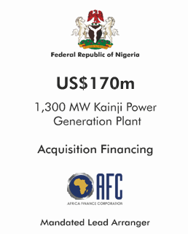
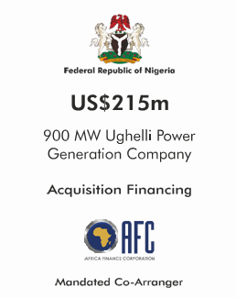
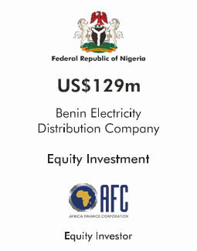



Appendix: Project Credentials…./1
Growing Africa Franchise: Recent Milestones.../2
Neconde Energy Limited (Nigeria)
US$160.0m
Federal Ministry of Finance
US$1.5bn
Vessel Fleet Acquisition
Senior Debt
Acquisition Finance
Critical Infrastructure Project Financing
Joint Financial Adviser
Joint Mandated Lead Arranger
Advisers
2012
2011 and 2012
2010 - 2011
16

Slide 17





Appendix: Project Credentials…./2
Growing Africa Franchise: Recent Milestones.../2
US$200.0m
Central Bank of Nigeria
US$230.0m
Secured pre-QPO Guaranteed Convertible Bonds
US$2.0bn
Senior Secured Syndicated Facility
Power and Aviation Intervention Fund
Anchor
Investor
Mandated Lead Arranger
Technical Adviser
2011
Ongoing
2011
WESTERN METAL PRODUCTS COMPANY LIMITED
US$50.0m
US$200.0m
US$240.0m
Working
Capital Facility
Expansion Capital International Equity Raising
Greenfield Equity
Financing
Sole Arranger
Equity Investment
Anchor Investor
2009 and 2010
2009 and 2010
2009
17

Slide 18
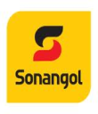





Appendix: Project Credentials…./3
Growing Africa Franchise: Recent Milestones.../2
US$120.0m
US$220.0m
US$75.0m
Sociedade Nacional de Combustíveis de Angola, E.P Crude Oil Refining
Société Anonyme Marocaine de l'Industrie du Raffinage
Republic of Zambia Petroleum Imports Facility
Syndicated Trade Finance Facility
Syndicated Trade Finance Facility
Trade Finance and Risk Participation Bank
2013
2012
2010, 2011, 2012
CABEOLICA SA
US$320.0m
€60.0m
US$1.2bn
Societe Ivoirienne de Raffinage Crude Oil Refining
Greenfield Project Development Financing for 28MW Wind Farm
Jubilee Oilfield Reserves-Based Lending Facility
Syndicated Trade Finance Facility
Co-Lead Developer
Mandated Lead
Arranger
2011
2010
2009
18

Slide 19





Appendix: Project Credentials…./4
Growing Africa Franchise: Recent Milestones.../2
€270.0m
US$50.0m
Konan Bedie Toll Bridge Financing
Expansion Capital Financing
US$150.0m
Structured Debt Financing
Junior Debt Mandated Lead
Arranger
Convertible Debt Investment
Senior Lender
2012
2012
2012
US$400.0m
US$85.0m
US$160.0m
Greenfield Port Facility
Aircraft Fleet Acquisition
Post-Completion Acquisition Financing
Mandated Lead
Arranger
Lead Arranger
Equity
Investment
Ongoing
2011
2010
19

